Slide 1

Academic Session 2025-26
EVEN Semester Jan-Jun 2026
UNIVERSITY INSTITUTE OF ENGINEERING
AIT-CSE
B.E CSE
AIML/ 6th
SOFTWARE ENGINEERING
23CSH-374
Faculty Name : Dr Geeta Rani CUmail-ID : geeta.e15227@cumail.in
Designation : Associate Professor

Slide 2
16
Course Objectives
Understand fundamental software engineering processes, SDLC models, and requirement engineering techniques used in real-world projects.
Apply modeling concepts, design principles, and UML diagrams to represent system structures and behaviors effectively.
Analyze various software development, design, and testing strategies to determine their suitability for different project scenarios.
Evaluate software solutions and project management practices based on quality metrics, design principles, and testing outcomes.
Create structured requirement documents, UML models, test plans, and project management artifacts for medium-scale software systems.

Slide 3

16
Course Outcomes
CO No. | Statement
CO1 | Explain SDLC models, requirement principles, testing strategies, and project management concepts.
CO2 | Construct UML diagrams and apply design patterns to solve software design problems
CO3 | Compare SDLC models, testing strategies for different scenarios.
CO4 | Assess testing strategies, maintenance approaches, and project metrics to ensure software quality.
CO5 | Develop complete requirement specifications, design models, test plans, and project management documents (including Jira-based defect tracking) for real-world case studies

Slide 4
23
Suggestive Readings
Text Books:
Pressman, R. S., “Software Engineering: A Practitioner’s Approach,” McGraw Hill.
Ian Sommerville, “Software Engineering,” Pearson.
Reference Books:
Pankaj Jalote, “An Integrated Approach to Software Engineering,” Narosa.
Ghezzi, Jazayeri, Mandrioli, “Fundamentals of Software Engineering,” PHI.

Slide 5
3
Unit-I Syllabus
Unit-1 | Unit 1: Software Process and Requirement Engineering (15 hours)
Chapter 1.1 | Software Engineering: Introduction, SDLC, Agile vs Traditional models.
Chapter 1.2 | Requirement Engineering: Elicitation, Analysis, Specification, Validation.
Chapter 1.3 | Case Studies: Requirements in online payment systems.

Slide 6
2
Recap of Previous Lecture
Discusses various SDLC Models and their comparison
Discussed AGILE Development Model
Agile methods are incremental development methods that focus on rapid software development, frequent releases of the software, reducing process overheads by minimizing documentation and producing high-quality code.

Slide 7
3
Topic
Introduction to Requirement Elicitation
Why Requirement Elicitation Is Important
Goals of Requirement Elicitation
Stakeholders in Requirement Elicitation
Elicitation Activities
Features of a Good SRS document

Slide 8
3
Introduction to Requirement Elicitation
Requirement Elicitation is the first and most crucial step of Requirement Engineering.It refers to the systematic process of gathering information from stakeholders to understand:
What the system should do
Constraints under which the system operates
User expectations and business needs
Elicitation bridges the gap between stakeholder needs and software solutions.

Slide 9
3
Why Requirement Elicitation Is Important
Helps identify real user needs, not assumptions
Builds a shared understanding among developers and customers
Reduces project failures caused by unclear or changing requirements
Supports creation of a clear, complete, and consistent SRS document
Saves time and cost by avoiding rework

Slide 10
3
Goals of Requirement Elicitation
Identify all stakeholders
Understand business goals and workflow
Discover functional and non-functional requirements
Reveal constraints, assumptions, and limitations
Resolve conflicts among stakeholders
Create a foundation for modeling, analysis, and specification

Slide 11
3
Stakeholders in Requirement Elicitation
End Users – people who use the system
Clients/Customers – who request or purchase the system
Business Managers – decision-makers
Domain Experts – subject-matter experts
Developers – build the software
Testers – test the software
System Administrators – maintain system operations

Slide 12
3
Elicitation Activities
Identifying stakeholders
Understanding the business environment
Planning elicitation techniques
Conducting elicitation sessions
Documenting findings
Validating collected requirements

Slide 13
3
Requirement Elicitation Techniques
Interviews
One-on-one or group
Types:
  Structured (pre-defined questions)
  Unstructured (free discussion)
  Semi-structured (combination)
Good for exploring user expectations, problems, and workflows

Slide 14
3
Requirement Elicitation Techniques
Questionnaires / Surveys
Used when many users are involved
Economical and quick
          Types:
          Open-ended
          Close-ended
          Brainstorming
          Group creativity session
          Generates innovative ideas and solution options
          Especially useful in early project stages

Slide 15
3
Requirement Elicitation Techniques
Workshops / Joint Application Development (JAD)
Conducted with multiple stakeholders and experts
Helps resolve conflicts
Produces well-defined requirements collaboratively
          Brainstorming
          Analyst observes users performing tasks.
          Types:
          Passive: Analyst watches but does not interrupt
            Active: Analyst participates or asks questions

Slide 16
3
Requirement Elicitation Techniques
Document Analysis
Examines existing:
Manuals
Forms
Reports
Previous system documentation
Useful for:
Understanding current problems
Identifying missing functionalities

Slide 17
4
Features of a Good SRS document
1️⃣ Correct – Requirements must accurately represent user needs.
2️⃣ Complete – All functional & non-functional requirements should be included.
3️⃣ Consistent – No conflicting requirements.
4️⃣ Unambiguous – Each requirement has only one clear meaning.
5️⃣ Verifiable – Requirements can be tested or checked.
6️⃣ Modifiable – Easy to update and change when needed.
7️⃣ Traceable – Each requirement can be traced to its source and forward to design/test cases.
8️⃣ Ranked for Priority – Clearly marked as essential, conditional, or optional.
9️⃣ Design-independent – Should specify what the system must do, not how to build it.
🔟 Understandable – Written in simple language for all stakeholders.

Slide 18
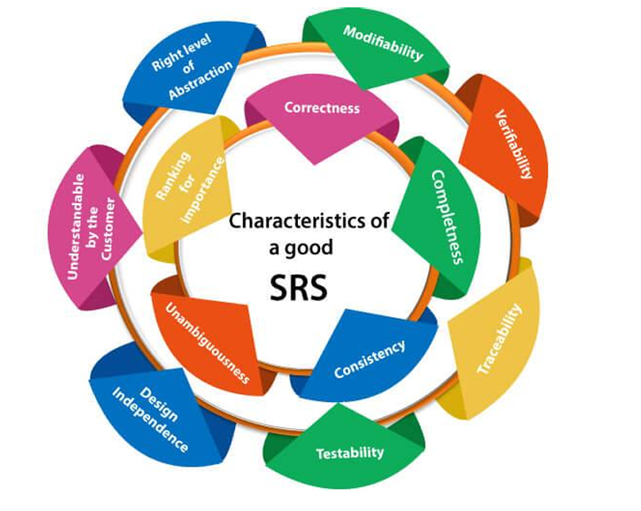
4
Features of a Good SRS document

Slide 19
Summary
7
A Software Requirements Specification (SRS) is a formal document that outlines the requirements of a software system to ensure a clear understanding between stakeholders, developers, and users. It defines both functional and non-functional requirements, ensuring the software operates as intended while meeting quality standards. A well-structured SRS should be correct, complete, consistent, unambiguous, verifiable, modifiable, and traceable, making it a vital reference throughout the development process. The requirement engineering process involves elicitation, analysis, documentation, validation, and management, ensuring that all user needs and business objectives are captured efficiently. The SRS document often follows the IEEE 830 standard, which provides guidelines for structuring requirements to maintain clarity and completeness. By defining the expected behavior of the software, SRS helps in project planning, validation, and aligning development efforts with user expectations. It serves as the foundation for successful software development and minimizes project risks by reducing ambiguities and misinterpretations early in the process.

Slide 20
8
Quiz/ FAQ’s
Why is an SRS important in software development?
What is the IEEE 830 standard for SRS?

Slide 21
10
Next lecture
Data modelling & Functional modelling

Slide 22
10
Faculty-curated videos, NPTEL, Coursera, LinkedIn, or other relevant learning resources
NPTEL — “Software Engineering” course from IIT Kharagpur / Indian Institutes https://onlinecourses.nptel.ac.in/noc25_cs108/preview?utm_source=chatgpt.com
CS & IT Tutorials by Vrushali — “SE 1: Learn Software Engineering from Scratch” (YouTube) https://www.youtube.com/watch?v=IHx9ImEMuzQ
nptelhrd (IIT/Bombay) — Lecture series “Introduction to Software Engineering” (free video lecture) https://www.youtube.com/watch?v=Z6f9ckEElsU&utm_source=chatgpt.com
Coursera – Introduction to Software Engineering (IBM) https://www.coursera.org/learn/introduction-to-software-engineering

Slide 23

11
Class-Wise Feedback

Slide 24
12
Thank You
For queries
Email: geeta.e15227@cumail.in

